Slide 1


Slide 2

ElectroLedger
Second Year Project Final Presentation
Submitted by
ROLL NUMBER | NAME
2301010231 | Vinay Partap Singh
2301010236 | Kirti Sahni
2301010211 | Abhinav Jha
2301010263 | Anushka Berlia
Industry Mentor: Mr. Ajay Kumar
Faculty Mentor: Dr. Archna Goyal
Notes:
New Courses replaced with New Programmes

Slide 3

Project Overview
ElectroLedger is a web application developed to help the user manage finances efficiently by recording income, expenses, and expenditure patterns. The interface is easy to use in adding transactions, categorizing expenditures, and representing financial data using charts and reports. It helps users manage finances better by giving insights, alerting budgets, and securely providing access to their personal financial records. Built with modern web technologies, the application is good for those interested in a basic but efficient approach to tracking expenditure.
Notes:
New Courses replaced with New Programmes

Slide 4
About the Problem
IDENTIFIED PROBLEMS
Keeping up with day-to-day expenditures proves to be quite a laborious task and highly prone to mistakes for an electronic store. Several people cannot even afford the hiring of a CA, thereby committing financial mistakes.
ISSUES OR PROBLEMS
No method to track the source of income and expenditure
Spending cannot be analyzed easily
No real-time budgeting and savings insights
Traditional methods involve notebooks or spreadsheets, which raise security concerns
REQUIREMENT OF SOLUTION
A modern, smart, automated system is needed by users to track their expenses effortlessly, helping in grouping transactions, and provide insights to enhance the planning and improvement of personal finance management. EXISTING SOLUTIONS
Traditional methods include spreadsheets and mobile apps . However most of them do not have an automated system and personalization with real-time insights, which can be less effective for modern users.
Notes:
New Courses replaced with New Programmes

Slide 5
Problem Statement
Managing financial records and monitoring spending are ongoing issues for an electronics store owner. Hiring a chartered accountant is not a practical choice due to budgetary limits, which makes it challenging to maintain correct accounts and guarantee appropriate financial planning. The shopkeeper needs a user-friendly website that can effectively track, arrange, and manage their daily spending, earnings, and total financial activities in order to solve this problem. This platform ought to make accounting chores easier, offer transparent financial data, and assist them in keeping better control over their company's finances without going over budget.
Notes:
New Courses replaced with New Programmes

Slide 6
Objectives
• Simplify Accounting Tasks – Offer an intuitive interface for recording sales, expenses, and profits without the need for accounting expertise.
• Ensure Accurate Financial Tracking – Automate calculations and generate real-time financial reports to maintain transparency.
• Enhance Budget Management – Help store owners monitor spending and optimize costs to improve profitability.
Suggest ways to save money based on spending habits.
Integration with UPI for automated entries.
Notes:
New Courses replaced with New Programmes

Slide 7
Methodology, Tools, and Techniques
Approach Taken to Solve the Problem
Developed a web-based expense tracker to streamline financial management for the electric store owner.
Implemented an intuitive user interface, which allows data entry and ease of categorizing expenses.
Integrated automated calculations of tax-related expenses, rent, and transportation.
Provided graphical insights and reports for better financial analysis and sound decision-making.
Tools, Software & Techniques Used
. Front-end: React.js, HTML, CSS, JavaScript . Back-end: Node.js, Express.js, Webhooks, TensorFlow . Database: MongoDB / Firebase . Charting & Reports: Chart.js / D3.js
Notes:
New Courses replaced with New Programmes

Slide 8
Methodology, Tools and Techniques
JUSTIFICATION FOR SELECTED TOOLS
. Web application: This can be accessed using any device with flexibility.
. Automatic tracking & reporting: It will reduce the efforts of a user and provide precision.
. Cloud Storage: This guarantees secure data storage and easy accessibility.
. User-friendly interface: Simplifies financial tracking without technical complications.

Slide 9
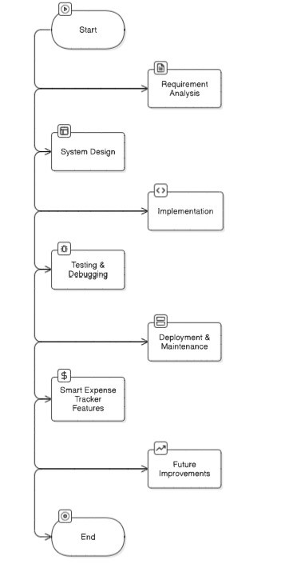
Methodology Flowchart
Notes:
New Courses replaced with New Programmes

Slide 10
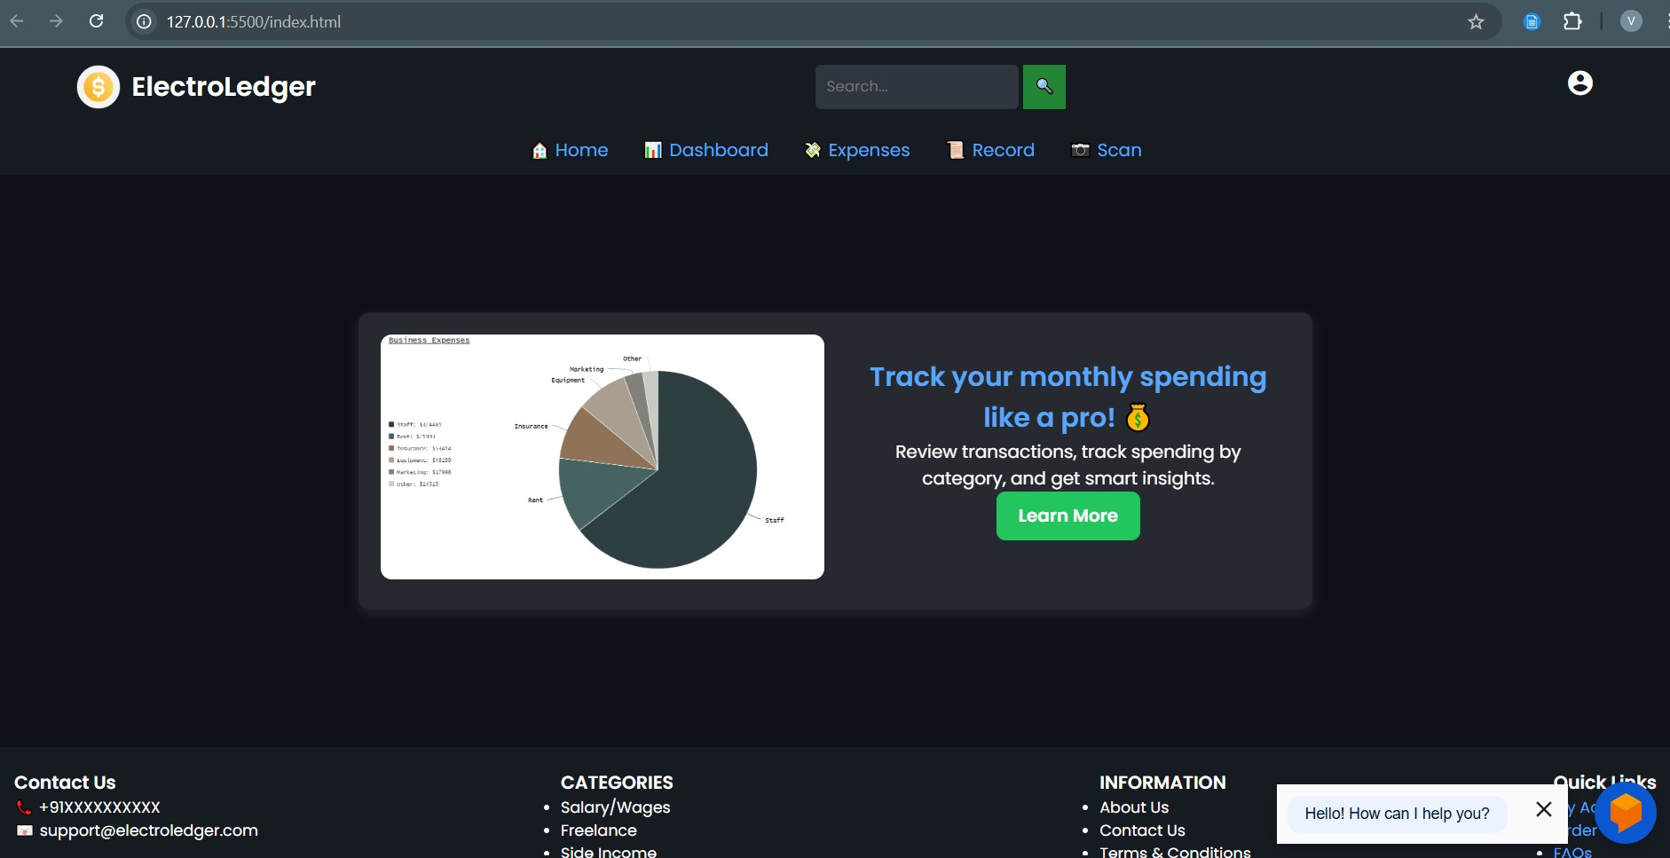
Few Glimpses of our website
Notes:
New Courses replaced with New Programmes

Slide 11
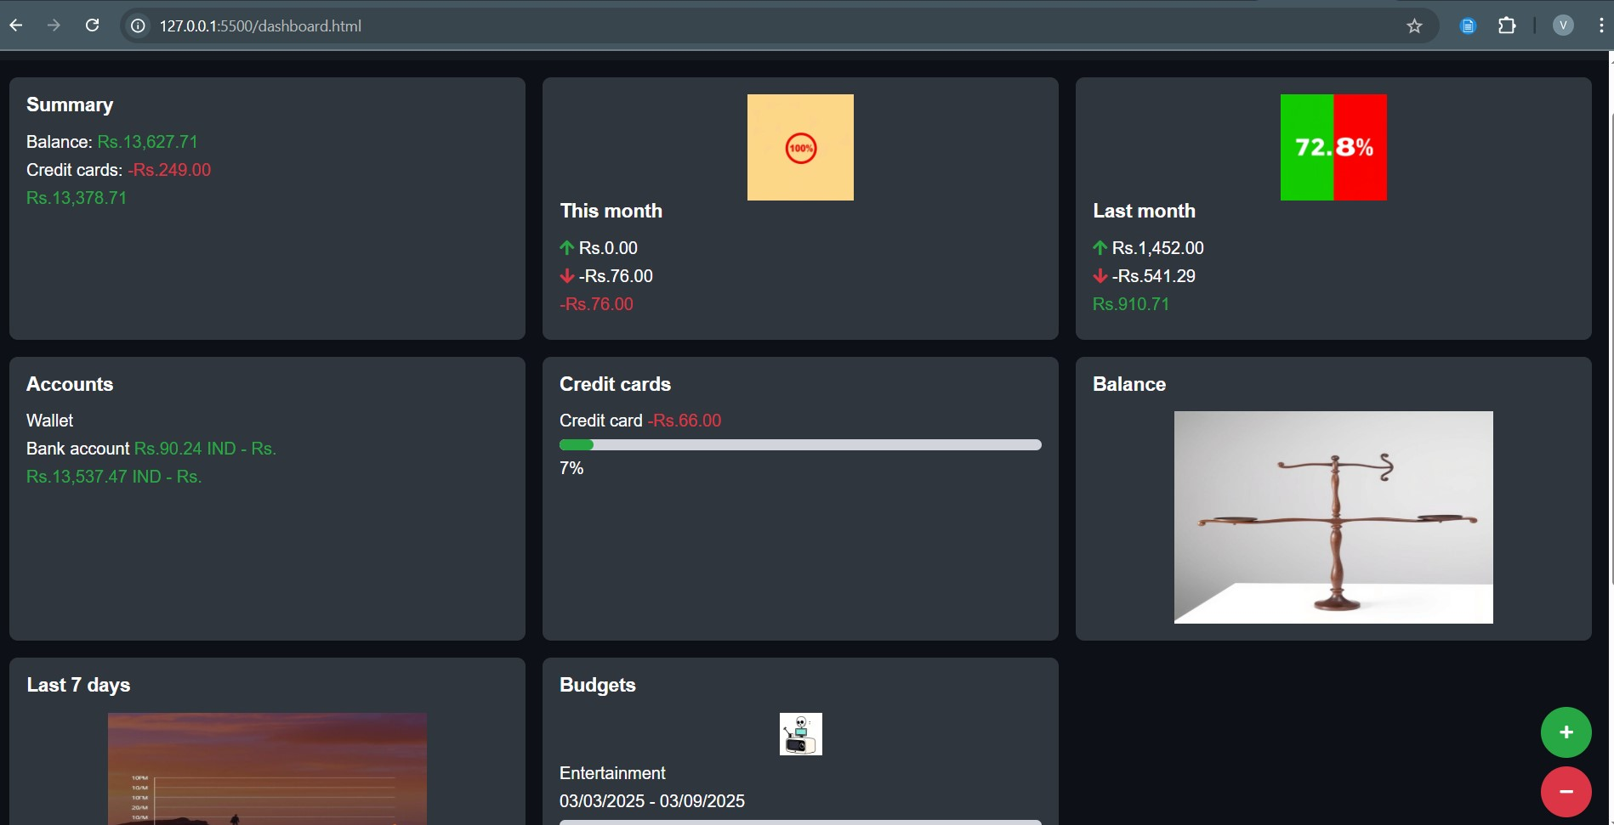
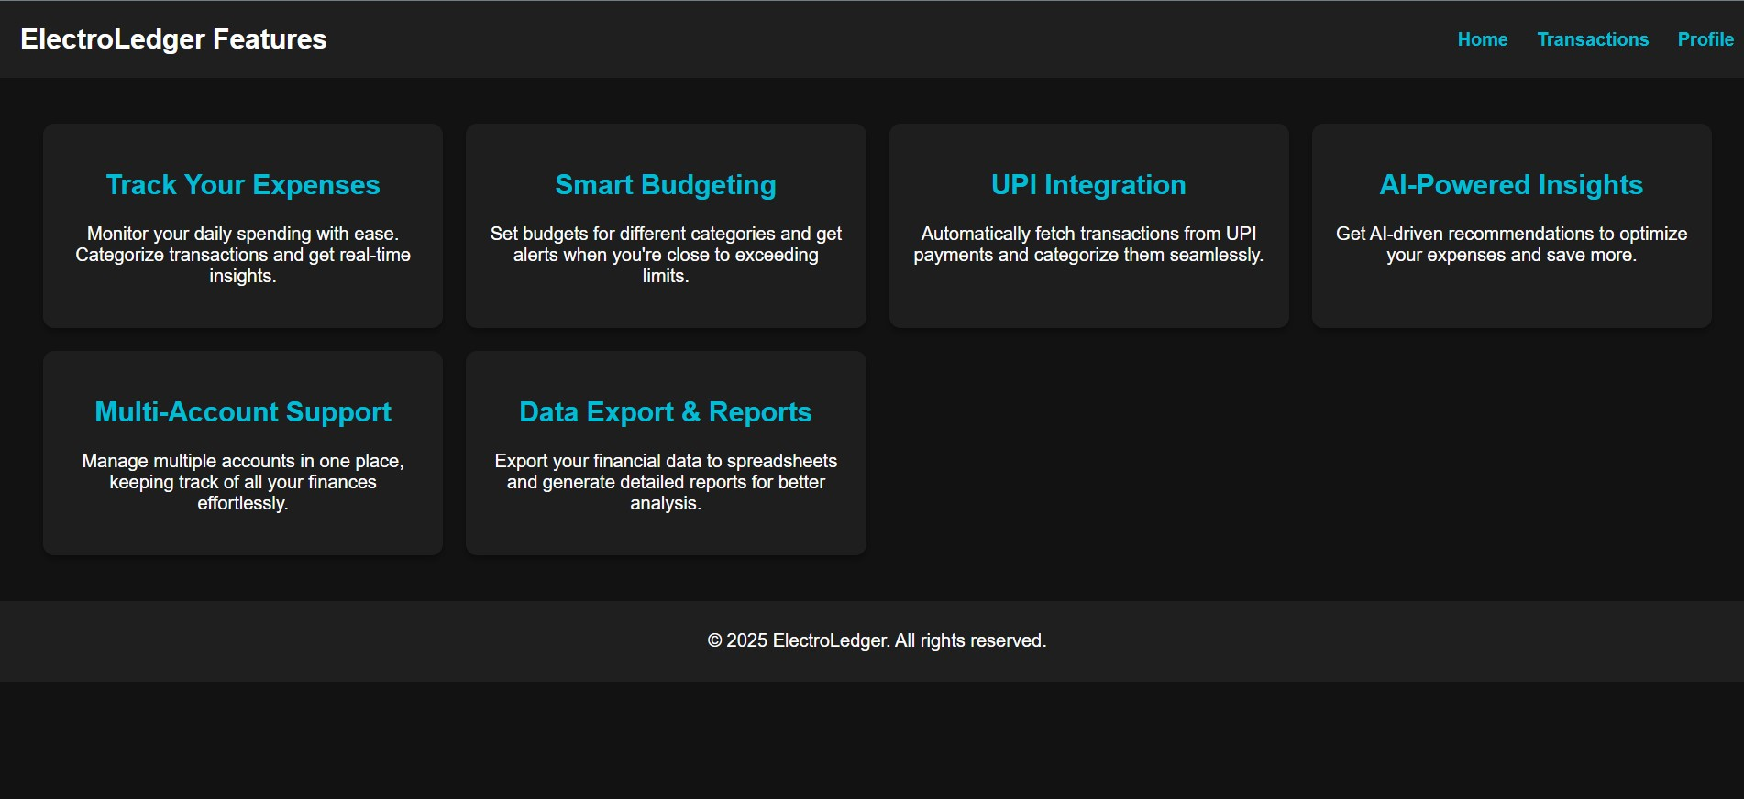
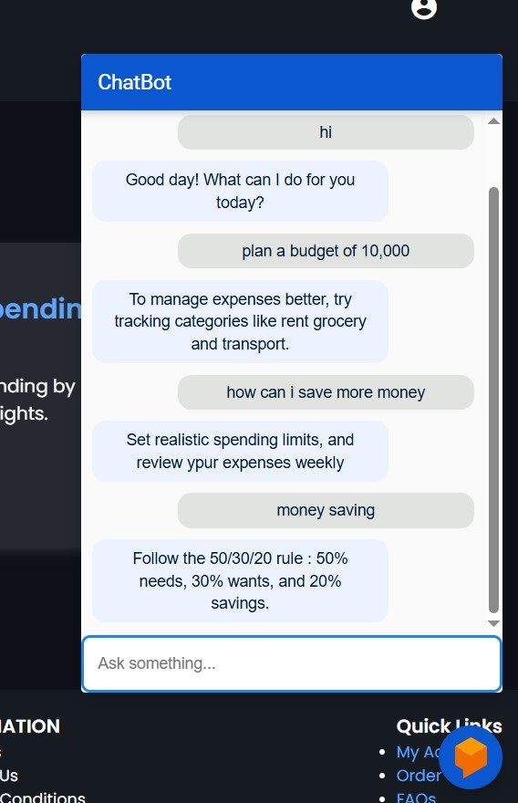
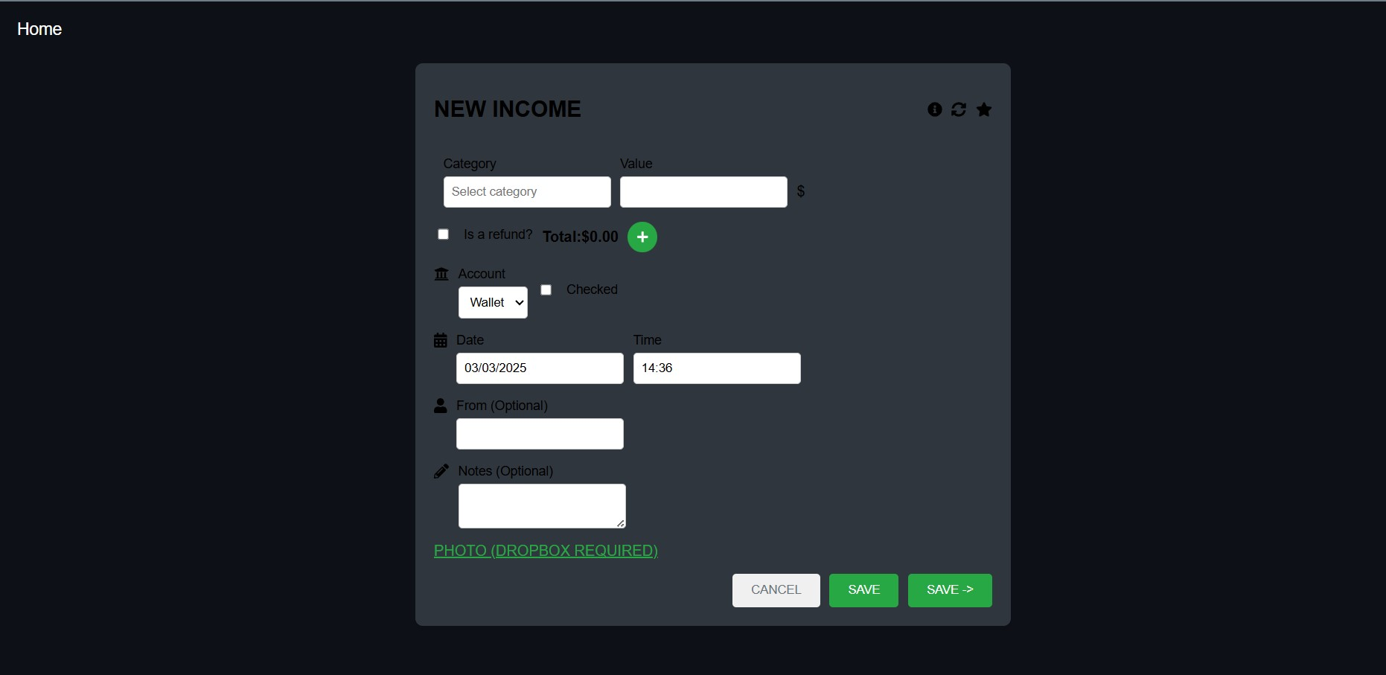

Slide 12
Learning and Experience
Working on Electroledger, an expense tracker application, was a valuable experience that strengthened both my technical and practical skills.
Throughout the project, I gained a deeper understanding of full-stack development and improved my ability to design user-friendly interfaces while ensuring data accuracy and secure storage.
I learned how to effectively manage financial data, implement features like transaction categorization, budget tracking, and data visualization, and work with technologies like HTML, CSS, Javascript Node.js, Mongo DB. This project also helped me improve my debugging and version control skills, especially through collaborative development and regular testing.
One of the key takeaways was understanding the importance of user experience in a financial tool—making the website both intuitive and reliable. Additionally, I improved my project planning and time management skills, particularly by breaking tasks into sprints and meeting milestones efficiently.

Slide 13
Future Improvements
AI-Powered Insights & Suggestions
What it does: Uses AI to analyze user spending habits and suggest saving opportunities, budgeting tips, or highlight unusual spending.
Why it's valuable: Users love personalized feedback; it makes the app feel more intelligent and helpful, not just a digital ledger.
2. Bank Account Syncing (Open Banking Integration)
What it does: Automatically pulls in transactions from linked bank accounts, credit cards, or digital wallets.
Why it's valuable: Eliminates manual entry, increases accuracy, and makes the app truly effortless for users.
3. Voice Input & Smart Assistants Integration
What it does: Allows users to add expenses via voice (e.g., "Hey Siri, log a $20 grocery expense").
Why it's valuable: Convenience. Especially handy for users on-the-go.

Slide 14
4. Shared & Collaborative Expenses
What it does: Enables expense sharing between friends, or roommates—ideal for managing shared bills, group trips, etc.
Why it's valuable: Highly requested by users who live or travel with others.
5. Subscription Management
What it does: Automatically detects and lists recurring subscriptions and alerts for upcoming renewals.
Why it's valuable: Helps users avoid unwanted charges and manage recurring spending.

Slide 15
THANK YOU

